Slide 1
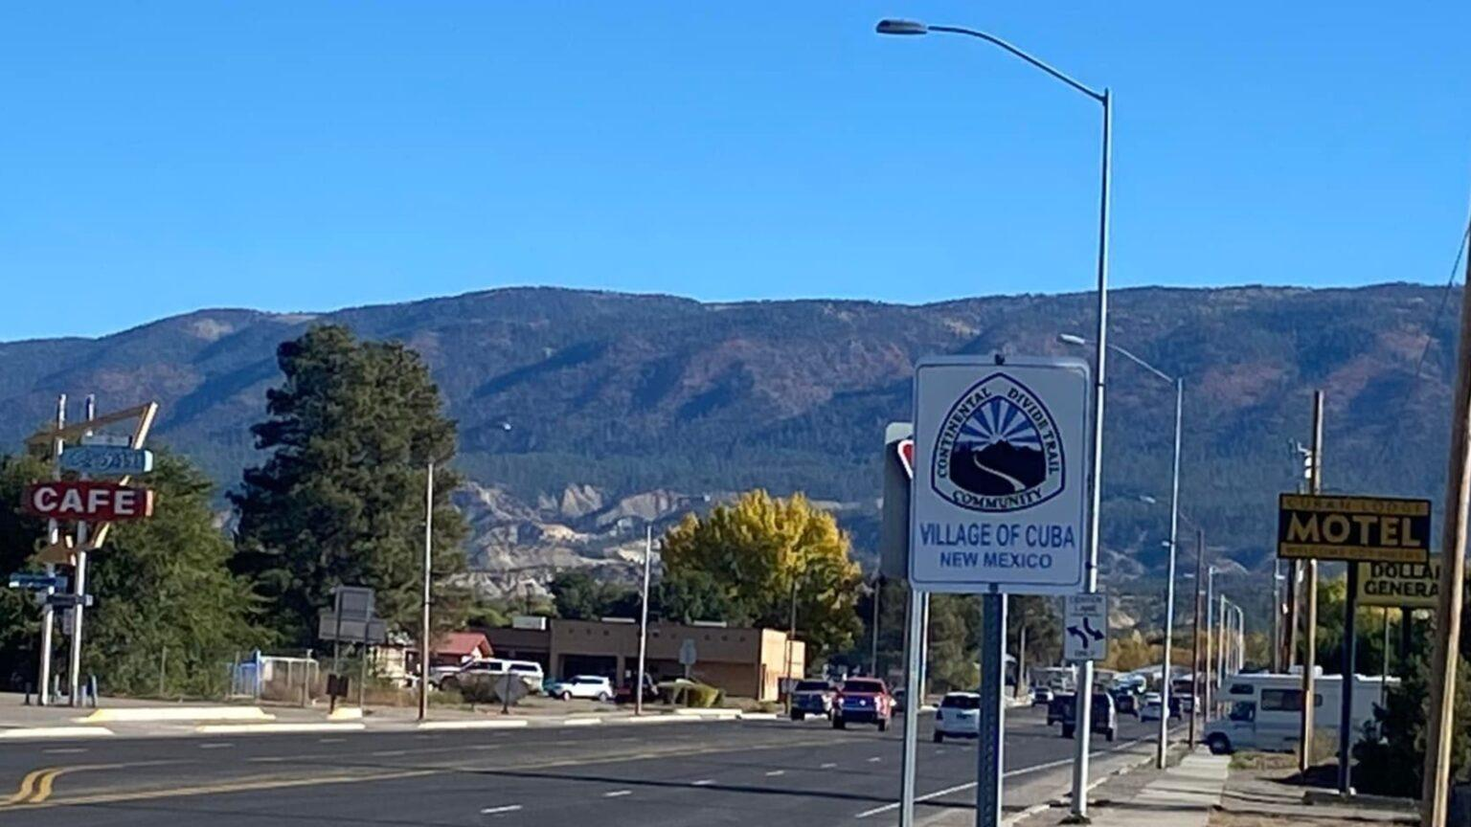
Cuba, New Mexico Project: Safety, Security, and Violence
Community risks, available evidence, and practical prevention
ENG 220 Section 001 | Team 2
Max Brewer (Prime Minister)
Rachael Stokes
Sierra Tsosie
Janet Ziglar
Brooke Morenus
Adam Branchal
November 16, 2026

Slide 2
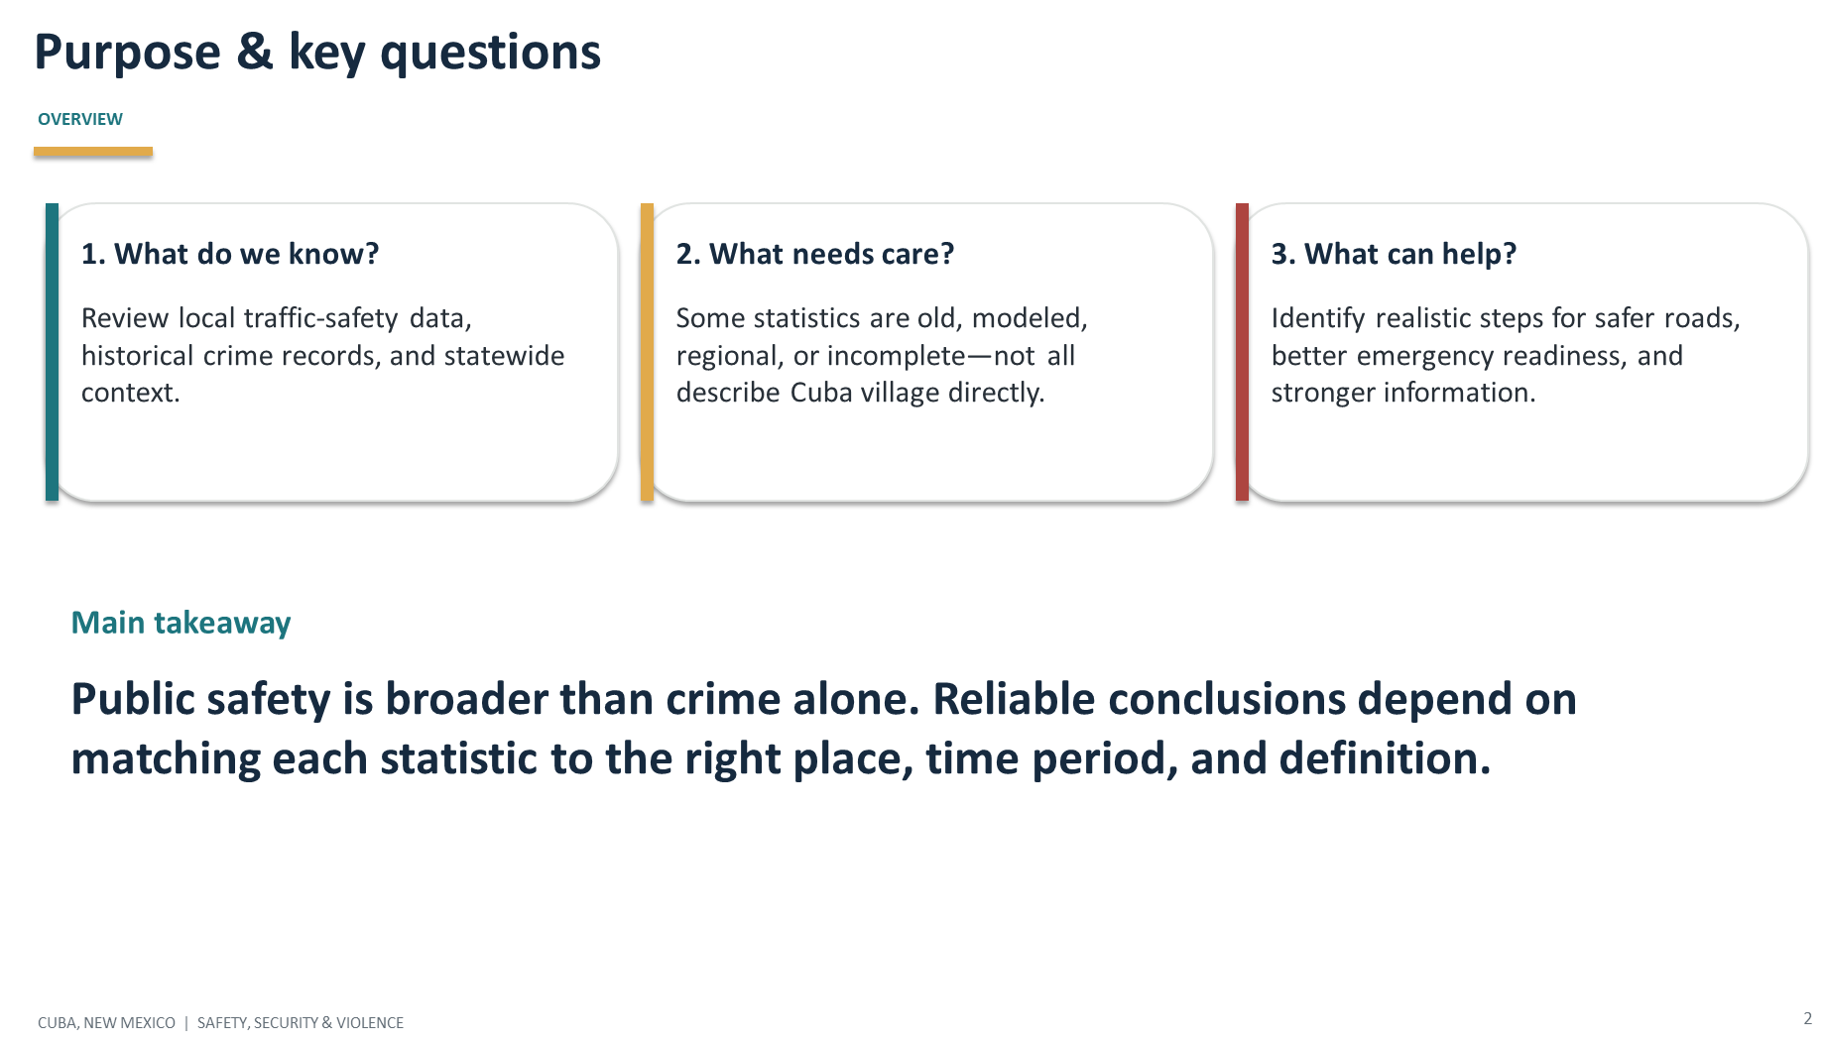

Slide 3
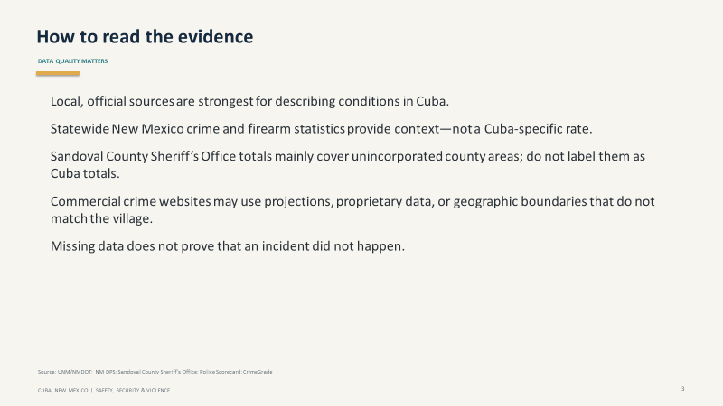

Slide 4
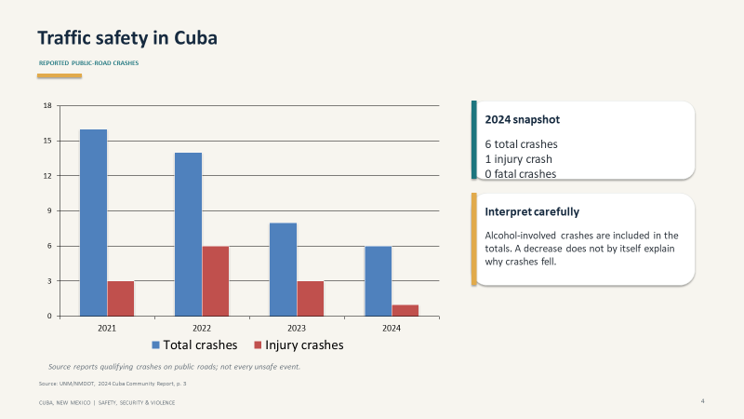

Slide 5
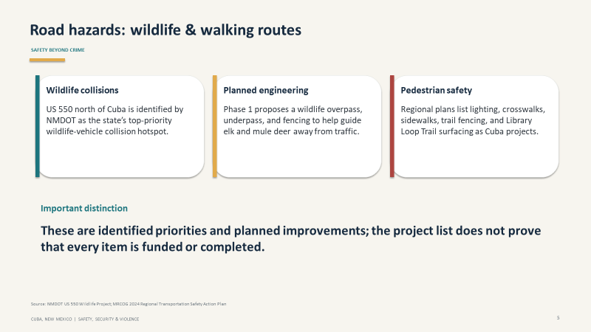

Slide 6
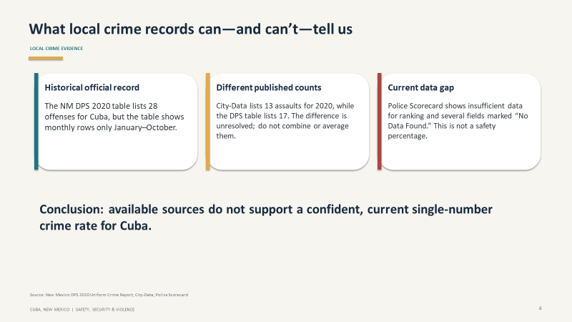

Slide 7
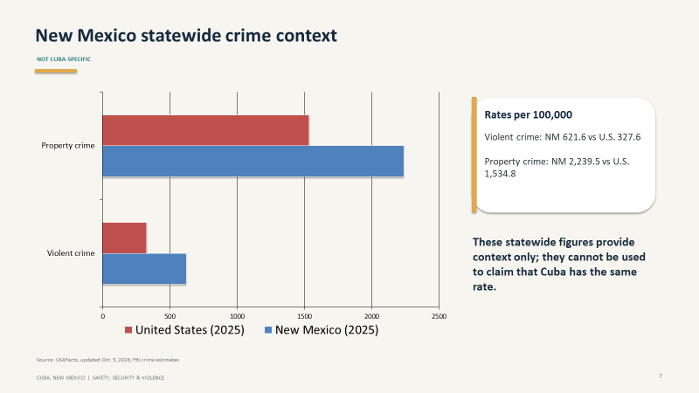

Slide 8
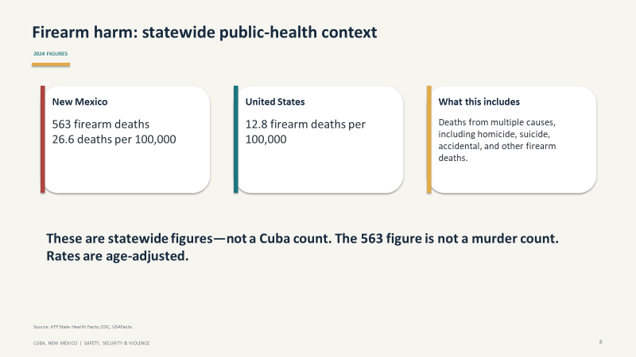

Slide 9
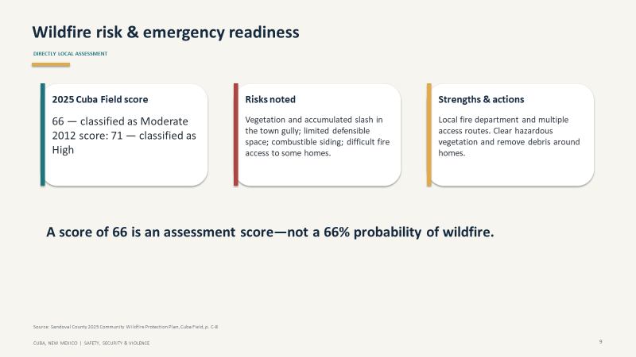

Slide 10
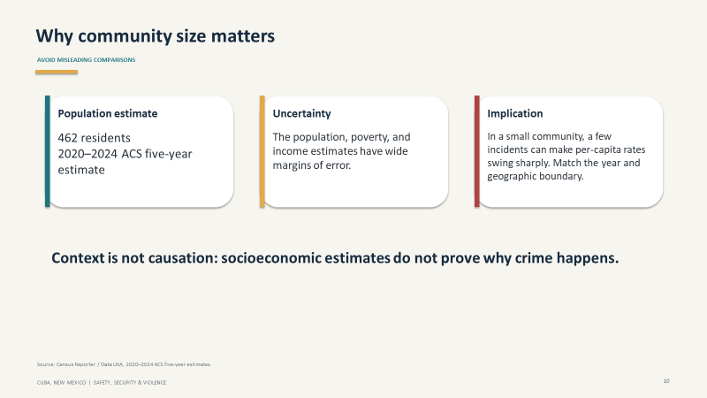

Slide 11
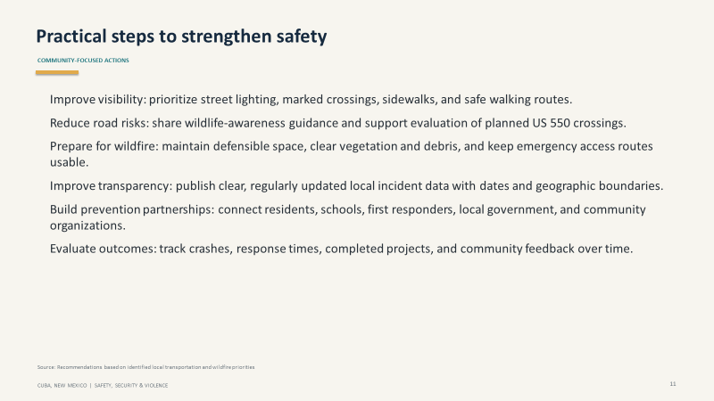

Slide 12
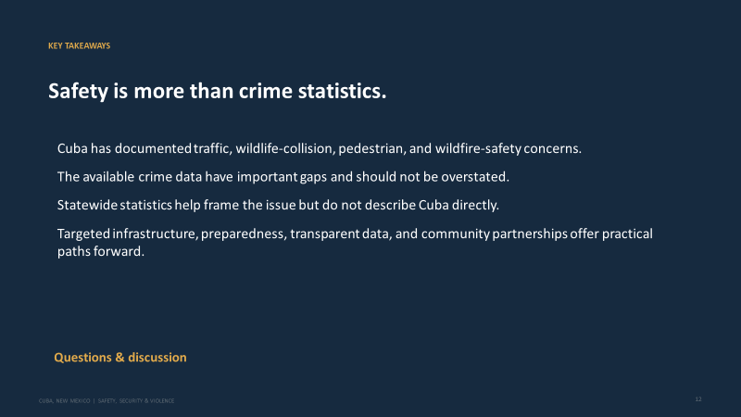

Slide 13
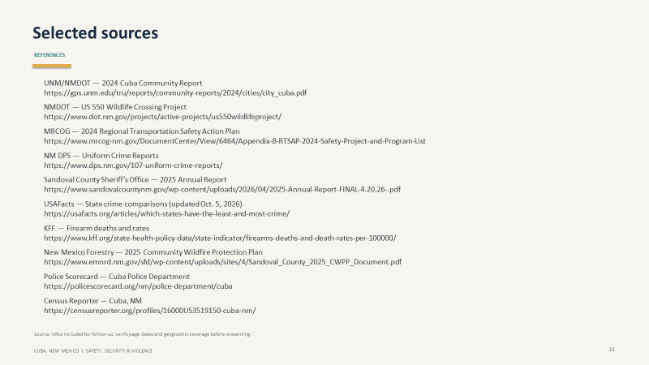

Slide 14
Hyperlinks:

